Slide 1
Java basics
Spring 2016
CS 215
B. M. Mainul Hossain
Acknowledgement: Aaron Bloomfield, MIT

Slide 2
DisplayForecast.java
// Authors: J. P. Cohoon and J. W. Davidson
// Purpose: display a quotation in a console window
public class DisplayForecast {
// method main(): application entry point
public static void main(String[] args) {
System.out.print("I think there is a world market for");
System.out.println(" maybe five computers.");
System.out.println(" Thomas Watson, IBM, 1943.");
}
}
// Authors: J. P. Cohoon and J. W. Davidson
// Purpose: display a quotation in a console window
public class DisplayForecast {
// method main(): application entry point
public static void main(String[] args) {
System.out.print("I think there is a world market for");
System.out.println(" maybe five computers.");
System.out.println(" Thomas Watson, IBM, 1943.");
}
}
// Authors: J. P. Cohoon and J. W. Davidson
// Purpose: display a quotation in a console window
public class DisplayForecast {
// method main(): application entry point
public static void main(String[] args) {
System.out.print("I think there is a world market for");
System.out.println(" maybe five computers.");
System.out.println(" Thomas Watson, IBM, 1943.");
}
}
// Authors: J. P. Cohoon and J. W. Davidson
// Purpose: display a quotation in a console window
public class DisplayForecast {
// method main(): application entry point
public static void main(String[] args) {
System.out.print("I think there is a world market for");
System.out.println(" maybe five computers.");
System.out.println(" Thomas Watson, IBM, 1943.");
}
}
// Authors: J. P. Cohoon and J. W. Davidson
// Purpose: display a quotation in a console window
public class DisplayForecast {
// method main(): application entry point
public static void main(String[] args) {
System.out.print("I think there is a world market for");
System.out.println(" maybe five computers.");
System.out.println(" Thomas Watson, IBM, 1943.");
}
}
// Authors: J. P. Cohoon and J. W. Davidson
// Purpose: display a quotation in a console window
public class DisplayForecast {
// method main(): application entry point
public static void main(String[] args) {
System.out.print("I think there is a world market for");
System.out.println(" maybe five computers.");
System.out.println(" Thomas Watson, IBM, 1943.");
}
}
// Authors: J. P. Cohoon and J. W. Davidson
// Purpose: display a quotation in a console window
public class DisplayForecast {
// method main(): application entry point
public static void main(String[] args) {
System.out.print("I think there is a world market for");
System.out.println(" maybe five computers.");
System.out.println(" Thomas Watson, IBM, 1943.");
}
}
// Authors: J. P. Cohoon and J. W. Davidson
// Purpose: display a quotation in a console window
public class DisplayForecast {
// method main(): application entry point
public static void main(String[] args) {
System.out.print("I think there is a world market for");
System.out.println(" maybe five computers.");
System.out.println(" Thomas Watson, IBM, 1943.");
}
}
// Authors: J. P. Cohoon and J. W. Davidson
// Purpose: display a quotation in a console window
public class DisplayForecast {
// method main(): application entry point
public static void main(String[] args) {
System.out.print("I think there is a world market for");
System.out.println(" maybe five computers.");
System.out.println(" Thomas Watson, IBM, 1943.");
}
}
// Authors: J. P. Cohoon and J. W. Davidson
// Purpose: display a quotation in a console window
public class DisplayForecast {
// method main(): application entry point
public static void main(String[] args) {
System.out.print("I think there is a world market for");
System.out.println(" maybe five computers.");
System.out.println(" Thomas Watson, IBM, 1943.");
}
}
// Authors: J. P. Cohoon and J. W. Davidson
// Purpose: display a quotation in a console window
public class DisplayForecast {
// method main(): application entry point
public static void main(String[] args) {
System.out.print("I think there is a world market for");
System.out.println(" maybe five computers.");
System.out.println(" Thomas Watson, IBM, 1943.");
}
}
// Authors: J. P. Cohoon and J. W. Davidson
// Purpose: display a quotation in a console window
public class DisplayForecast {
// method main(): application entry point
public static void main(String[] args) {
System.out.print("I think there is a world market for");
System.out.println(" maybe five computers.");
System.out.println(" Thomas Watson, IBM, 1943.");
}
}
Three comments
Three statements make up the action of method main()
Method main() is part of class DisplayForecast
A method is a named piece of code that performs some action or implements a behavior
An application program is required to have a public static void method named main().
public, static, and void are keywords. They cannot be used as names
public means the method is shareable
We will discuss static and void later
Java allows a statement to be made up of multiple lines of text
Semicolons delimit one statement from the next
A class defines an object form. An object can have methods and attributes
Keyword class indicates a class definition follows
A class like a method must have a name
A class like a method must have a name
Programs are read by people – make sure they are readable.
Use whitespace, comments, and indentation to aid understanding
// indicates rest of the line is a comment
Comments are used to document authors, purpose, and program elements

Slide 3
Indentation
// Authors: J. P. Cohoon and J. W. Davidson
// Purpose: display a quotation in a console window
public class DisplayForecast {
// method main(): application entry point
public static void main(String[] args) {
System.out.print("I think there is a world market for");
System.out.println(" maybe five computers.");
System.out.println(" Thomas Watson, IBM, 1943.");
}
}
Method main() is part of DisplayForecast
Statements are part of method main()
Indentation indicates subcomponents

Slide 4
Good whitespacing
// Authors: J. P. Cohoon and J. W. Davidson
// Purpose: display a quotation in a console window
public class DisplayForecast {
// method main(): application entry point
public static void main(String[] args) {
System.out.print("I think there is a world market for");
System.out.println(" maybe five computers.");
System.out.println(" Thomas Watson, IBM, 1943.");
}
}
Whitespace
Whitespace separates program elements
Whitespace between program elements is ignored by Java

Slide 5
Bad whitespacing
The same program without any whitespacing or comments:
public class DisplayForecast2 { public static void main (String[] args) { System.out.print("I think there is a world market for"); System.out.println(" maybe five computers."); System.out.println(" Thomas Watson, IBM, 1943."); } }

Slide 6
Keywords
Some words are reserved, and can’t be used as identifiers
// Authors: J. P. Cohoon and J. W. Davidson
// Purpose: display a quotation in a console window
public class DisplayForecast {
// method main(): application entry point
public static void main(String[] args) {
System.out.print("I think there is a world market for");
System.out.println(" maybe five computers.");
System.out.println(" Thomas Watson, IBM, 1943.");
}
}
// Authors: J. P. Cohoon and J. W. Davidson
// Purpose: display a quotation in a console window
public class DisplayForecast {
// method main(): application entry point
public static void main(String[] args) {
System.out.print("I think there is a world market for");
System.out.println(" maybe five computers.");
System.out.println(" Thomas Watson, IBM, 1943.");
}
}
// Authors: J. P. Cohoon and J. W. Davidson
// Purpose: display a quotation in a console window
public class DisplayForecast {
// method main(): application entry point
public static void main(String[] args) {
System.out.print("I think there is a world market for");
System.out.println(" maybe five computers.");
System.out.println(" Thomas Watson, IBM, 1943.");
}
}

Slide 7
Capitalization
Case matters!
public ≠ Public ≠ PUBLIC
This is different than FORTRAN and BASIC
This is the same as C/C++
You can use Public as a identifier
Not recommended, though!

Slide 8
Statements
A statement in Java is (usually) a single line
Example: System.out.println (“Hello world!”);
All statements must end with a semi-colon
That tells Java that the statement is finished

Slide 9
Package and Import
import java.util.Calendar;
import java.util.Date;
public class MathDemo
{
public static void main(String[] args)
{
Calendar calendar = Calendar.getInstance();
calendar.set(2012, 8, 19);
Date firstDate = calendar.getTime();
calendar.set(2012, 8, 1);
Date secondDate = calendar.getTime();
System.out.println("First date is :" + firstDate);
System.out.println("Second date is : " + secondDate);
}
}

Slide 10
Package and Import
import java.util.Calendar;
import java.util.Date;
public class MathDemo
{
public static void main(String[] args)
{
Calendar calendar = Calendar.getInstance();
calendar.set(2012, 8, 19);
Date firstDate = calendar.getTime();
calendar.set(2012, 8, 1);
Date secondDate = calendar.getTime();
System.out.println("First date is :" + firstDate);
System.out.println("Second date is : " + secondDate);
}
}
First date is : Wed Sep 19 15:12:39 EDT 2012
Second date is : Sat Sep 01 15:12:39 EDT 2012

Slide 11
Package and Import
import java.util.Calendar;
import java.util.Date;
public class MathDemo
{
public static void main(String[] args)
{
Calendar calendar = Calendar.getInstance();
calendar.set(2012, 8, 19);
Date firstDate = calendar.getTime();
calendar.set(2012, 8, 1);
Date secondDate = calendar.getTime();
System.out.println("First date is :" + firstDate);
System.out.println("Second date is : " + secondDate);
}
}

Slide 12
Package and Import
import java.util.Date;
public class MathDemo
{
public static void main(String[] args)
{
Calendar calendar = Calendar.getInstance();
calendar.set(2012, 8, 19);
Date firstDate = calendar.getTime();
calendar.set(2012, 8, 1);
Date secondDate = calendar.getTime();
System.out.println("First date is :" + firstDate);
System.out.println("Second date is : " + secondDate);
}
}
MathDemo.java:8: error: cannot find symbol
Calendar calendar = Calendar.getInstance();

Slide 13
Package and Import
import java.util.Calendar;
import java.util.Date;
public class MathDemo
{
public static void main(String[] args)
{
Calendar calendar = Calendar.getInstance();
calendar.set(2012, 8, 19);
Date firstDate = calendar.getTime();
calendar.set(2012, 8, 1);
Date secondDate = calendar.getTime();
System.out.println("First date is :" + firstDate);
System.out.println("Second date is : " + secondDate);
}
}

Slide 14
Package and Import
import java.util.Calendar;
public class MathDemo
{
public static void main(String[] args)
{
Calendar calendar = Calendar.getInstance();
calendar.set(2012, 8, 19);
Date firstDate = calendar.getTime();
calendar.set(2012, 8, 1);
Date secondDate = calendar.getTime();
System.out.println("First date is :" + firstDate);
System.out.println("Second date is : " + secondDate);
}
}
MathDemo.java:12: error: cannot find symbol
Date secondDate = calendar.getTime();

Slide 15
Package and Import
import java.util.*;
public class MathDemo
{
public static void main(String[] args)
{
Calendar calendar = Calendar.getInstance();
calendar.set(2012, 8, 19);
Date firstDate = calendar.getTime();
calendar.set(2012, 8, 1);
Date secondDate = calendar.getTime();
System.out.println("First date is :" + firstDate);
System.out.println("Second date is : " + secondDate);
}
}

Slide 16
Package and Import
import java.util.*;
public class MathDemo
{
public static void main(String[] args)
{
Calendar calendar = Calendar.getInstance();
calendar.set(2012, 8, 19);
Date firstDate = calendar.getTime();
calendar.set(2012, 8, 1);
Date secondDate = calendar.getTime();
System.out.println("First date is :" + firstDate);
System.out.println("Second date is : " + secondDate);
}
}
First date is : Wed Sep 19 15:12:39 EDT 2012
Second date is : Sat Sep 01 15:12:39 EDT 2012

Slide 17
Variables

Slide 18
Defining variables
We’ve seen variables before in math
y = mx + b
Here y, m, x, and b can hold any value
To store things in a computer program, we also use variables
Example:
int x = 5;
Visualization:
This defines an integer variable with value 5
The variable is x
The type is int
x
5

Slide 19
More on variables
An integer variable can only hold integers
In other words, it can’t hold 4.3
To hold floating point values, we use the double type
double d = 4.3;
The variable is d
The type is double
d
4.3

Slide 20
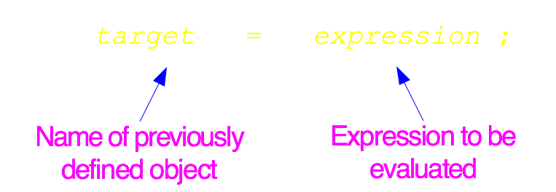


Primitive variable assignment
Assignment operator =
Allows the memory location for a variable to be updated
Consider
int j = 11;
j = 1985;
Assignment operator =
Allows the variable to be updated
Consider
int j = 11;
j = 1985;
Notes:
Besides signaling in a variable definition that the variable is to be initialized, the symbol = is also the Java assignment operator. The assignment operator takes two operands. The left operand is the target variable; the right operand is the modifying expression. When evaluated, the assignment operator updates the value in the memory location associated with a target variable based on the modifying expression.
The assignment operator works in the following manner. First, the left operand is evaluated to make sure that its value can be modified (e.g., a non-final variable). The right operand then is evaluated and its value is used to update the memory location associated with the left operand. For our particular assignment, the memory location associated with variable j is reset to the int value 1985. The assignment expression is read as “j gets 1985” or “j is assigned 1985.”

Slide 21
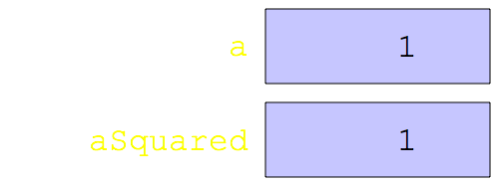

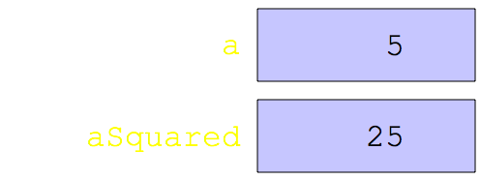
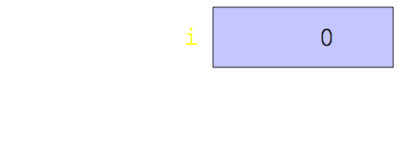
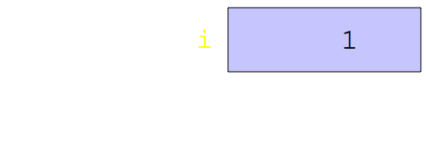
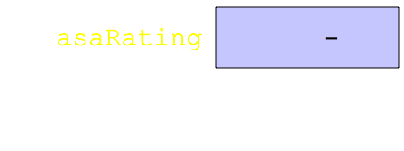
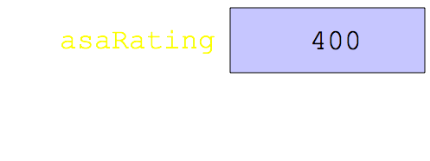
Primitive variable assignment
Consider
int a = 1;
int aSquared = a * a;
a = 5;
aSquared = a * a;
Consider
int i = 0;
i = i + 1;
Consider
int asaRating;
asaRating = 400;
int a = 1;
int aSquared = a * a;
a = 5;
aSquared = a * a;
int i = 0;
i = i + 1;
int asaRating;
asaRating = 400;

Slide 22
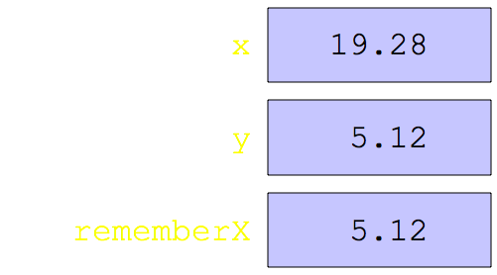
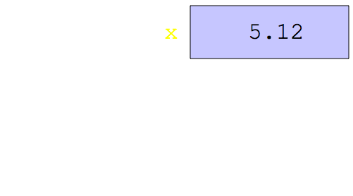
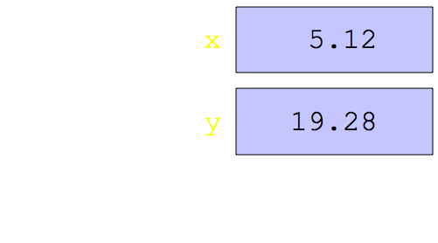
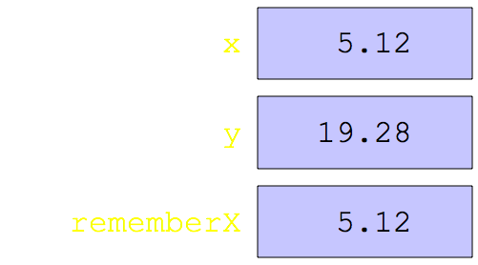

Primitive variable assignment
Consider
double x = 5.12;
double y = 19.28;
double rememberX = x;
x = y;
y = rememberX;
Consider
double x = 5.12;
double y = 19.28;
double rememberX = x;
x = y;
y = rememberX;
Consider
double x = 5.12;
double y = 19.28;
double rememberX = x;
x = y;
y = rememberX;
Consider
double x = 5.12;
double y = 19.28;
double rememberX = x;
x = y;
y = rememberX;
Consider
double x = 5.12;
double y = 19.28;
double rememberX = x;
x = y;
y = rememberX;
Consider
double x = 5.12;
double y = 19.28;
double rememberX = x;
x = y;
y = rememberX;

Slide 23
Printing variables
To print a variable to the screen, put it in a System.out.println() statement:
int x = 5;
System.out.println (“The value of x is “ + x);
Important points:
Strings are enclosed in double quotes
If there are multiple parts to be printed, they are separated by a plus sign

Slide 24
Variable initialization
Note that the following
int x;
x = 5;
is (mostly) the same as the following:
int x = 5;

Slide 25
You can only declare variables once
The following code will not work:
int x = 5;
int x = 6;
Java can have only one variable named x
So you can’t declare multiple variables with the same name
(we’ll see ways around this later in the semester)

